Slide 1
Lecture # 4
CSC336 Web Technologies
Credit Hours: 3(2, 1)

Slide 2

Tables, Div, Span, and Layout Design in HTML

Slide 3

Introduction to HTML Layout
HTML PROVIDES BASIC ELEMENTS FOR STRUCTURING WEB CONTENT.
FOCUS ON TABLES, DIV, AND SPAN
FOR LAYOUT DESIGN.
THESE ELEMENTS HELP ORGANIZE CONTENT WITHIN A WEBPAGE.

Slide 4

What Are HTML Tables?
Tables are used to present data in a tabular format.
Consist of rows and columns.
Commonly used for structuring data, not for page layout (although it was used for layout in the past).

Slide 5
Basic Table Structure
<table>
<thead>
<tr>
<th>Header 1</th> <th>Header 2</th>
</tr>
</thead>
<tbody>
<tr>
<td>Data 1</td> <td>Data 2</td>
</tr>
</tbody>
</table>
Example of a simple table with headers and data rows.
• html
• Copy code
• <table>
• <tr>
• <th>Header 1</th>
• <th>Header 2</th>
• </tr>
• <tr>
• <td>Data 1</td>
• <td>Data 2</td>
• </tr>
• </table>

Slide 6
Table Elements
<table>: Defines the table structure.
<tr>: Table row.
<td>: Table data (cell).
<th>: Table header (bold and centered by default).

Slide 7







Using Tables for Layout (Deprecated)
In early web design, tables were used to structure entire web pages.
Example:
This method is now discouraged in favor of more flexible elements.
<table>
<thead>
<tr>
<th>Header</th>
</tr>
</thead>
<tbody>
<tr>
<td>Content</td>
</tr>
</tbody>
<tfoot>
<tr>
<td>Footer</td>
</tr>
</tfoot>
</table>
• html
• Copy code
• <table>
• <tr>
• <td>Header</td>
• </tr>
• <tr>
• <td>Content</td>
• </tr>
• <tr>
• <td>Footer</td>
• </tr>
• </table>

Slide 8


Table Attributes
border: Adds a border around the table and cells.
cellpadding: Adds space inside table cells.
cellspacing: Adds space between table cells.
Example: <table border="1" cellpadding="5" cellspacing="5">...</table>

Slide 9
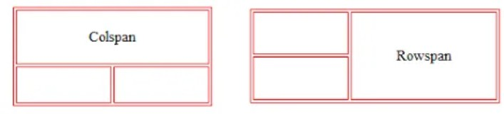
Colspan Vs Rowspan

Slide 10
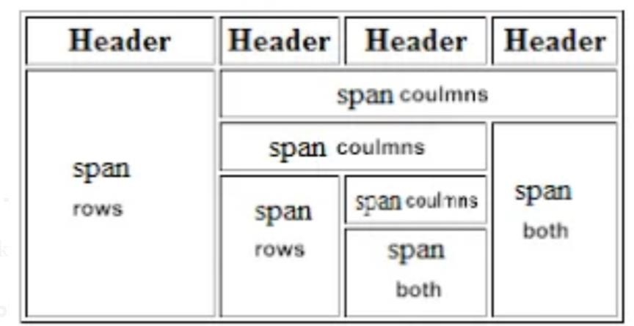
HTML tables can have cells that span over multiple rows and/or columns.

Slide 11

Merging Cells in Tables
Use colspan and rowspan to merge cells:
<td colspan="2">Merged Column</td>
<td rowspan="2">Merged Row</td>

Slide 12
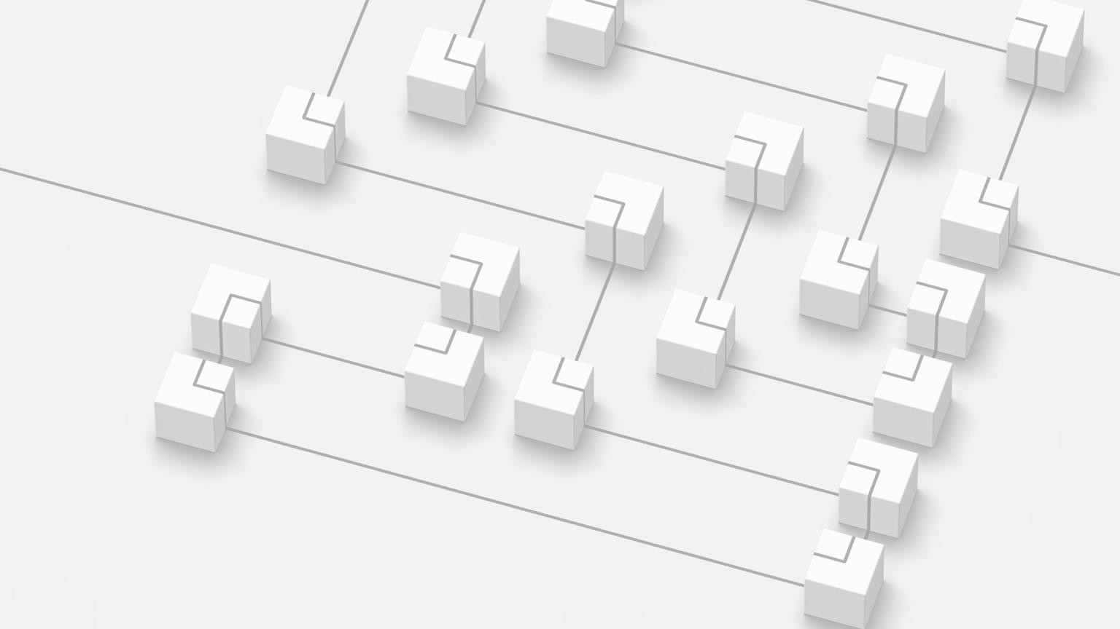
Introduction to Div
<div>: A block-level element used to group and structure content.
Used for creating sections of a webpage.
Unlike tables, <div> is better suited for flexible layout design.

Slide 13
Basic Example of a Div
Groups content together for layout and styling purposes.
<div>
<h1>Title</h1>
<p>This is a paragraph inside a div.</p>
</div>

Slide 14
Div for Page Sections
Example of a common webpage structure using <div>:
<div id="header">Header</div>
<div id="content">Main Content</div>
<div id="footer">Footer</div>
Helps to create logical page divisions.

Slide 15
Introduction to Span
<span>: An inline element used to group text for styling.
Does not create a new block on the page.
Best for styling small sections of text.

Slide 16
Basic Example of Span
<p>This is a <span>highlighted</span> word in a sentence.</p>
The <span> element is used inside paragraphs or headings to apply different styles.

Slide 17



<div>:
Block-level element.
Creates a new line.
Used for sections of content.
<span>:
Inline element.
Stays on the same line.
Used for small sections of text.
Div vs Span

Slide 18
Layout Design with Tables (Example)
<table>
<thead>
<tr>
<th>Header</th>
</tr>
</thead>
<tbody>
<tr>
<td>Content</td>
</tr>
</tbody>
<tfoot>
<tr>
<td>Footer</td>
</tr>
</tfoot>
</table>
• html
• Copy code
• <table>
• <tr>
• <td>Header</td>
• </tr>
• <tr>
• <td>Main Content</td>
• </tr>
• <tr>
• <td>Footer</td>
• </tr>
• </table>
This is how early web layouts were designed, using tables to divide the page into sections.

Slide 19
Div for Layout (Example)
<div id="container">
<div id="header">Header</div>
<div id="main-content">Main Content</div>
<div id="footer">Footer</div>
</div>
<div> is now the preferred method for creating page sections.
• html
• Copy code
• <div id="container">
• <div id="header">Header</div>
• <div id="main-content">Main Content</div>
• <div id="footer">Footer</div>
• </div>

Slide 20
Nesting Divs
You can nest <div> elements inside each other for more complex layouts.
Example:
<div class="container">
<div class="left">Left Section</div>
<div class="right">Right Section</div>
</div>
• html
• Copy code
• <div class="container">
• <div class="left">Left Section</div>
• <div class="right">Right Section</div>
• </div>

Slide 21
More flexible and accessible than tables.
Importance of Using Div for
Layout
Works well with modern web design practices.
Easy to style using CSS (covered later).

Slide 22
Use <div> for block-level content or sections.
Use <span> for inline text or small elements within other content.
Avoid using tables for layout, as it is less responsive and harder to maintain.
Layout Best Practices with Div and Span

Slide 23


Avoiding Tables for
Layout
Tables should be reserved for tabular data (e.g., spreadsheets, data tables).
Using tables for page layout makes the site less responsive and more difficult to style.

Slide 24
Tables are useful for tabular data, but not for layout.
Lesson Learning Outcomes (LLOs)
Div is the standard for page sections and layout.
Span is used for inline styling of text.
Organize and structure your content with these elements to build well-structured web pages.

